Slide 1
IoT and Azure
David Gristwood
davidgri@microsoft.com
@ScroffTheBad

Slide 2
Agenda
Case studies
IoT Services
Putting it all together
… lead into next session on data

Slide 3



“The more data we have, the more we can learn and put together algorithms to predict problems. It’s about taking information to make systems even more efficient and productive.”
DOUG WEBER
BUSINESS MANAGER,
REMOTE APPLICATION MONITORING
ROCKWELL AUTOMATION
Notes:
Slide goal:
Provide a real-world example of a customer developing an IoT solution
Key points:
Rockwell Automation is an industrial automation company from Milwaukee, WI
Developed a solution that enables petroleum industry customers to monitor their expensive capital assets and provide near-real-time insight into the operation of machinery (often in remote, isolated regions)
This allows customers to reduce downtime and maintenance of assets, increasing productivity
From this original solution, Rockwell was able to expand their asset monitoring and management capabilities by incorporating big-data analytics tools from Microsoft Azure, allowing them to analyze massive amounts of raw telemetry data and manage complex data interactions across multiple systems
This provides their customers with advanced analytics that provide actionable information to inform their business decision-making
Presenter guidance:
Unless your audience is very IT-savvy, keep the information at a high-level
Potentially frame this as:
Problem: For petroleum industry customers, managing and operating their machinery and other assets is a constant challenge. These machines are expensive, remote, and often hard to get to. Unexpected downtime and increased maintenance of assets for Rockwell’s petroleum industry customers was impacting their productivity and increasing costs over time
Solution: Rockwell develop an IoT solution that provided remote asset monitoring and management capabilities
Customer impact: Rockwell’s customers were able to reduce downtime and maintenance of assets, increasing productivity
Partner outlook: Rockwell was able to expand their asset monitoring and management capabilities by incorporating big-data tools from Microsoft Azure, allowing them with massive amounts of data and manage complex interactions across customers – enabling them to provide their customers with new and improved services
For customers who want more information, use the “Watch Video” button in the bottom left-hand corner to show them the video case study
Talk track:
An industrial automation company based out of Milwaukee, Wisconsin, Rockwell Automation is using IoT to help customers transform their operations within the petroleum industry. Their solution monitors expensive capital assets, and provides a near-real-time view of the operation of machinery in remote, isolated regions. Because Rockwell is now able to remote monitor assets worldwide, they are able to reduce costly downtime and maintenance of assets, and increase productivity. As a result of Rockwell’s end-to-end approach, customers are changing the way they manage their entire oil and gas supply chain.
And Rockwell didn’t stop there. They soon expanded on the asset monitoring and management capabilities of their solution to include a broad data strategy that incorporates big-data analytics tools, including Azure HDInsight and Azure Data Factory, to allow them to manage complex data interactions across multiple systems and analyze massive amounts of raw telemetry data. For customers, this advanced analytics feature brings actionable, predictive information that facilitates and informs business decision-making.
Harnessing the potential of the data collected from the ocean floor to the gas pump on the corner, Rockwell Automation is using IoT to light up traditional pump, transport and metering equipment with cloud-connected sensors, and is providing customers with new forms of insight and value that even they didn’t expect at the time of developing the solution. It’s all about capturing new data streams, and turning that data into insights and action.
<Click>

Slide 4


The Internet of Things gives the world’s cities a major lift
THYSSENKRUPP ELEVATOR VIDEO
CHALLENGE
SOLUTION
BENEFITS
Leading global manufacturer ThyssenKrupp Elevator maintains more than elevators worldwide, including those at some of the1.1 million world’s most iconic buildings. ThyssenKrupp wanted to better compete in their industry by offering dramatically increased uptime, taking preventative maintenance a step further to predictive and even pre-emptive service.
ThyssenKrupp teamed up with Microsoft and CGI to create a connected, intelligent asset monitoring system based on Microsoft Azure Intelligent Systems Service, Power BI for Office 365, and Microsoft Azure Machine Learning. The solution connects thousands of sensors and systems in its elevators to the cloud and draws this data into a dashboard available on PCs and mobile devices for a real-time view of key performance indicators.
.
Increases reliability through predictive maintenance and rapid, remote diagnostic capabilities
Reduces costs for ThyssenKrupp and their customers
Rich, real-time data visualization
Data continually feeds into dynamic predictive models
“We wanted to go beyond the industry standard of preventative maintenance, to offer predictive and even preemptive maintenance.”
Andreas Schierenbeck CEO
Notes:
ThyssenKrupp Elevator - a leading global provider of elevators - has 1.1 million machines operating in 150 countries, 49,000 employees, and reported sales of EUR €6.2 billion (US $8.4 billion) in 2013. With installations in iconic buildings worldwide, ThyssenKrupp wanted to further improve its competitive advantage by increasing elevator reliability and uptime.
With help from Microsoft partner CGI, TKE created an intelligent, cloud-based solution based on Microsoft Azure Intelligent Systems Services, Power BI for Office 365, and Microsoft Azure Machine Learning that automatically collects, analyzes, and visualizes data from thousands of sensors and systems to enable real-time, actionable insight into current performance as well as predictive maintenance. And with Power BI connected to Microsoft Azure ISS, field techs using mobile apps and control center analysts working with a cloud-based dashboard can access and visualize the same data simultaneously for collaborative trouble-shooting.
Increases reliability and reduces costs through predictive maintenance and rapid, remote diagnostic capabilities
Rich, real-time data visualization
Data continually feeds into dynamic predictive models
Two-way flow of data enables diagnostics mode and remote elevator commands
*Please click the hyperlink on the company name in the slide to view customer content. If the name is not hyperlinked, no additional materials are available.
Microsoft Azure
Azure Machine Learning
Power BI for Office 365

Slide 5
























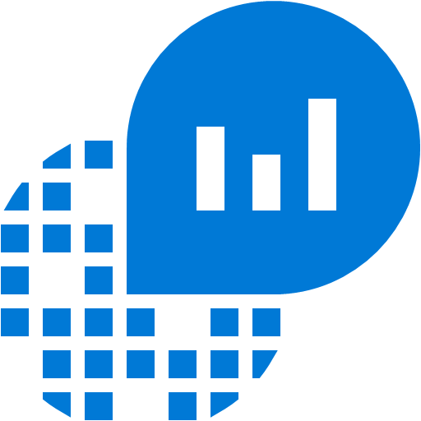



























Platform Services
Security & Management
Compute
Web and Mobile
Developer Services
Hybrid
Operations
Cloud
Services
Service
Fabric
Web Apps
API
Apps
API
Management
Visual Studio
Azure SDK
Portal
Azure AD
Connect Health
Batch
Remote App
Mobile
Apps
Logic
Apps
Notification
Hubs
Team Project
Application
Insights
Active
Directory
AD Privileged
Identity
Management
Multi-Factor
Authentication
Integration
Analytics & IoT
Data
Backup
Storage
Queues
Biztalk
Services
Automation
HDInsight
Machine
Learning
SQL
Database
SQL Data
Warehouse
Operational
Insights
Hybrid
Connections
Service
Bus
Key Vault
Data
Factory
IoT and Event
Hubs
Redis
Cache
Search
Import/Export
Store /
Marketplace
Media & CDN
Site
Recovery
Stream
Analytics
Mobile
Engagement
DocumentDB
Tables
VM Image Gallery
& VM Depot
Media
Services
Content Delivery
Network (CDN)
StorSimple
Infrastructure Services
Compute
Storage
Networking
Virtual Machines
Containers
BLOB Storage
Azure Files
Premium Storage
Virtual Network
Load Balancer
DNS
Express
Route
Traffic Manager
VPN Gateway
Application Gateway
Datacenter Infrastructure (24 Regions, 19 Online)

Slide 6







Analytics and IoT Transform data into intelligent action
Information Management
Big Data Stores
Machine Learning and Analytics
Dashboards and Visualizations
Business apps
Power BI
Azure
Data Factory
Azure
Machine Learning
Personal Digital Assistant
Azure
Data Lake store
Cortana
Azure Data Lake analytics service
People
Custom apps
Azure
Data Catalog
Perceptual Intelligence
Azure HDInsight
(Hadoop and Spark)
Face, vision
Azure
SQL Data Warehouse
Speech, text
Azure
IoT Hub
Azure
Stream Analytics
Business Scenarios
Sensors and devices
Recommendations,
customer churn,
forecasting, etc.
Automated Systems
DATA
INTELLIGENCE
ACTION

Slide 7
Connect & Control Azure IoT Hub

Slide 8
Azure IoT Hub
Designed for IoT
Connect up to 10 million devices
Service assisted communications
Secure bi-directional communication
Command and control
Cloud-scale messaging
Device-to-cloud and Cloud-to-device
Durable messages (at least once semantics)
Cloud-facing telemetry ingestion
Delivery receipts, expired messages
Device communication errors
Per-device authentication
Individual device identities and credentials
Connection multiplexing
Single device-cloud connection for all communications (C2D, D2C)
Multi-protocol support
Natively supports AMQP, HTTP
Designed for extensibility to custom protocols
Multi-platform
Device SDKs available for multiple platforms (e.g. RTOS, Linux, Windows)
Multi-platform Service SDK.
Notes:
As a component IoT hub offers massive scalability with support for up to 10 million devices per instance. Additional instances can be created if required. Secure two way communication and command control (to a device level) can be achieved through IoT Hub. Device health telemetry can be displayed through the IoT Hub portal in the preconfigured solution offering real time insights into the performance of a device. Communication errors and faulty assets can be identified and flagged for attention or simply removed from the system. Tighten security through per device ID and credential authentication. IoT Hub natively supports AMQP and HTTP protocols and is designed to extensively support custom protocols where required. Multi platform SDKs are available for different OS’s and languages.
IoT HUB:
Connect up to 10 million devices per instance
Secure two way communication
Command and control
Monitor device health and connectivity
Troubleshoot individual devices
Native AMQP, HTTP support – custom protocol support
Multi platform SDK support for RTOS, Linux, Windows
Per/device authentication

Slide 9


Connect your devices to Azure
IoT Hub
Event processing and insight
(e.g., hot and cold paths)
IP-capable
Cloud protocol
gateway
Device business logic,
connectivity monitoring
Field gateway
PAN-devices
Application device provisioning and management
field
cloud

Slide 10
IoT Hub endpoints
Your IoT Hub
Event processing
(hot and cold path)
Device
Device ID
D2C receive endpoint
D2C send endpoint
Device business logic,
connectivity monitoring
C2D queue
endpoint
C2D send endpoint
Field GW/
Cloud GW
Msg feedback and monitoring endpoint
Device …
Device …
Device provisioning and management
Device identity management
Device …
IoT Hub management

Slide 11
Event Processing Azure Stream Analytics

Slide 12
Real time event processing
Uncover real time insights
Perform real time analytics across multiple streams
Rapid Deployment
Use simple SQL syntax, auto distributed for scale
Mission critical reliability
Fully managed, low latency, high throughput
Create real time alerts
Flag alerts and alarms for attention
High volume
Analyze millions of data points per second
Highly scalable
Enterprise grade, predictable solution.
Notes:
ASA can not only handle millions of events per second but it can also correlate across multiple independent streams of data simultaneously. This high speed event processing allows for the real time detection of anomalies or escalations based on threshold breaches or alarm settings as the data is ingested. The architecture is simple and easily scalable to an enterprise ready solution.
Azure Stream Analytics:
Real time analytics
Millions of events per second
Low latency, high througput

Slide 13

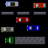
Working with Streaming Data
Data at Rest
Data in Motion

Slide 14
Windowing Concepts
Windows can be tumbling, hopping, or sliding
Windows are fixed length
Must be used in a GROUP BY clause
Output event will have the timestamp of the end of the window
Window 1
Window 2
Window 3
1
5
4
6
2
8
6
4
Time
t1
t2
t3
t4
t5
t6
Aggregate
Function (Sum)
Output Events
18
14

Slide 15
Hopping Windows
A 10-second Hopping Window with a 5-second “Hop”
1
5
4
6
2
8
6
5
3
6
1
0
5
10
15
20
25
30
Time
(secs)
1
5
4
6
2
“Every 5 seconds give me the count of tweets over the last 10 seconds”
4
6
2
8
6
8
6
5
3
5
3
6
1
SELECT Topic, Count(*) AS TotalTweets
FROM TwitterStream
TIMESTAMP BY CreatedAt
GROUP BY Topic, HoppingWindow(second, 10, 5)

Slide 16
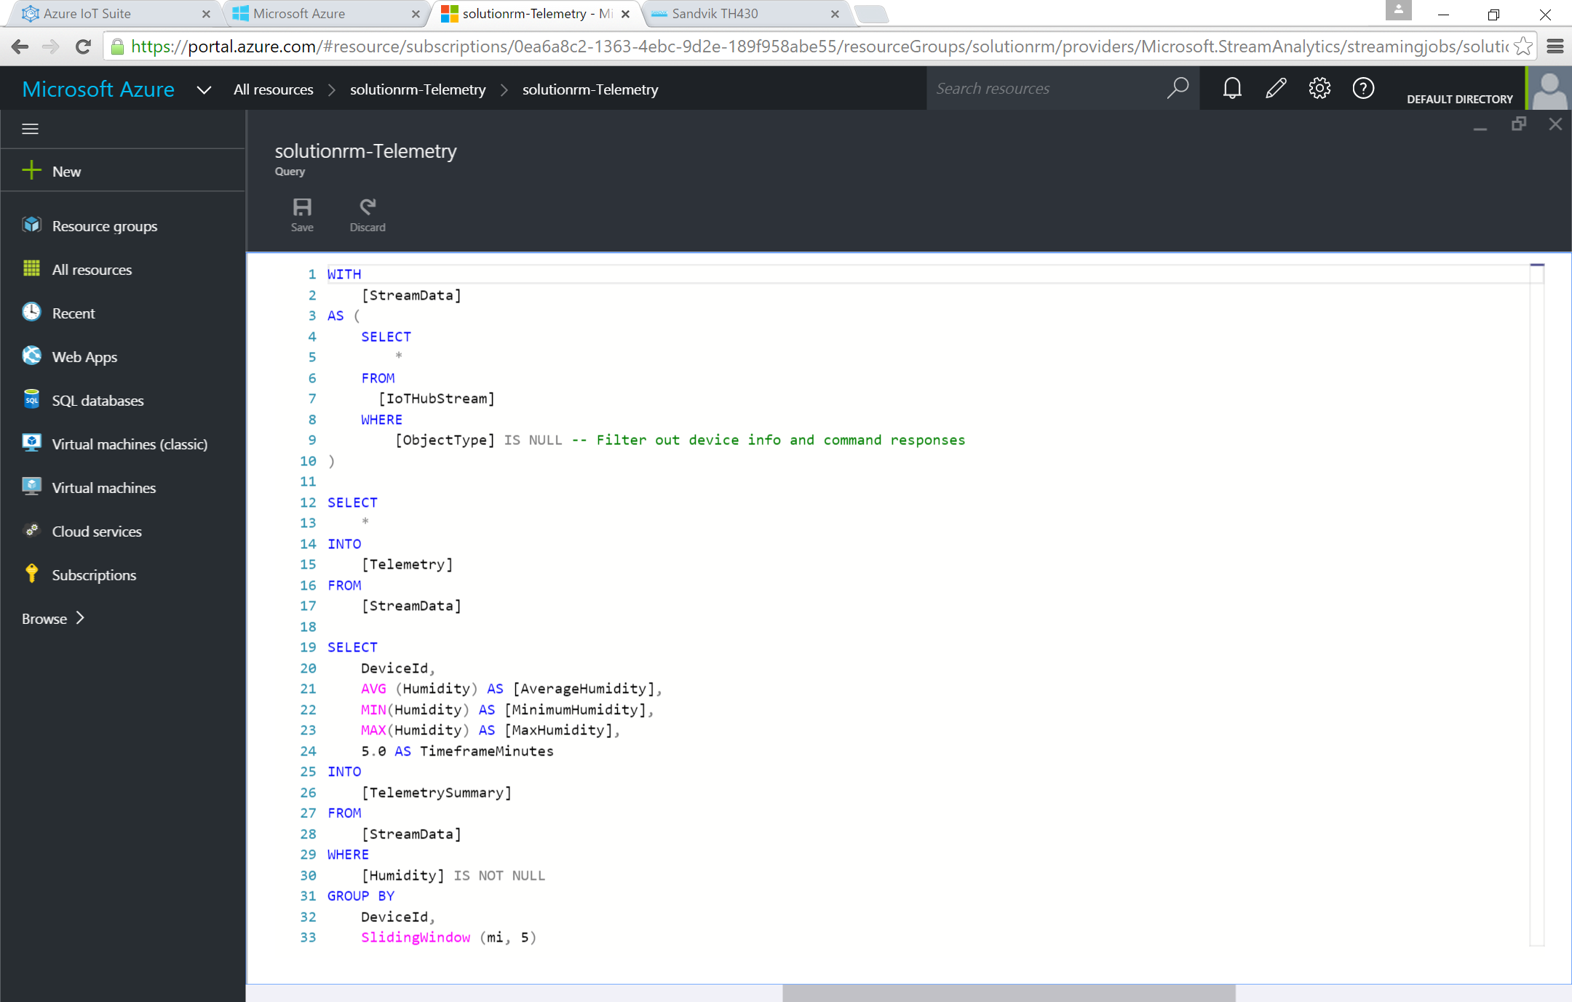
Add or edit jobs using simple ASA interface
Rule based interface
Simple implementation and rule development using ASA UI.
Multi-channel
Analyze multiple channels of information simultaneously, in real time.
Notes:
Utilize the simple ASA rule based interface within the Azure Management Portal to create, manage and control rules.
Azure Stream Analytics:
Simple interface for rule development and management

Slide 17
Data Visualization Power BI
Notes:
PowerBI – Data Visualization

Slide 18
Data visualization with PowerBI
Highly accessible analytics
Cloud based dashboard and analytics tool,
360º view of business KPI’s
Customize dashboards to address concerns and performance metrics.
Cross platform support
View data via web platform, on any device
Pre-built dashboards
Utilize standard dashboards for rapid deployment, based on popular solution demands.
Real time capabilities
Ingest, analyze and display data as it happens
Secure access
Secure, live communication with data source
Query data
Intuitive, natural language query tool
Integrated systems
Integrate with other business systems and enrich device data with intelligence from other business systems, eg: CRM, ERP
Notes:
PowerBI is a cloud based (with desktop capabilities) dashboard and analytics tool. Quickly develop deep-dive dashboards for a 360-degree view of important business metrics. Data can be easily called and analyzed within a dashboard, drilled down deeper and even queried with native language search functions for ad-hoc requests or simple dashboard development. Integrate simply to other line of business by pushing feeds or embedding assets within other applications.
PowerBI
Cloud based analytics
Preconfigured dashboards
Easily view KPI’s
Native language queries
Integrate/embed in existing or proprietary systems

Slide 19
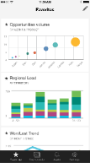
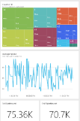
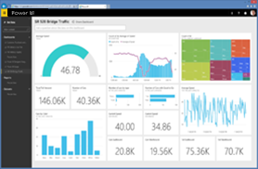
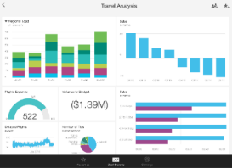
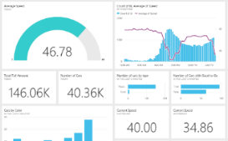
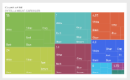
Power BI Overview
Data sources
Power BI service
SaaS solutions
e.g. Marketo, Salesforce, GitHub, Google analytics
Content packs
Natural language query
Sharing & collaboration
On-premises data
e.g. Analysis Services
Live dashboards
Organizational content packs Corporate data sources or external data services
Visualizations
Azure services
Azure SQL, Stream Analytics…
Reports
Excel files
Workbook data / data models
01001
10101
Power BI Desktop files
Data from files, databases, Azure, and other sources
Datasets
Data refresh
Notes:
1. The Power BI service, sometimes referred to as powerbi.com, is what allows you to:
Create beautiful visualizations to tell compelling data stories
Build rich, live dashboards that turn BI into business insights
Create reports & datasets from which you can create visualizations and dashboards
Enjoy the benefits of up-to-date data with real-time, automatic and scheduled refreshes
Share dashboards easily with other people in your organization
Ask questions of data in plain English with Natural Language Query
Stay connected to your data all the time with mobile applications
2. Power BI connects to a variety of data sources. These range across both cloud and on-premises sources, and include:
A variety of popular SaaS solutions, such as Marketo, Salesforce, GitHub, Dynamics CRM, Zendesk, and several others
On-premises databases – Power BI offers live connectivity to SQL Server Analysis Services, which we’ll cover in more detail later. And using a gateway solution, Power BI can connect to other database solutions.
Custom data sources – Power BI can connect to any data source you need it to thanks to its extensibility via REST APIs. This includes both proprietary corporate data sources, as well as external data services. For example, if you are a SaaS solution provider, you can work with Microsoft to connect your solution to Power BI.
Other Azure services – Power BI integrates tightly with SQL Azure and Stream Analytics, and will be integrating closely with more Azure services over time
Power BI Desktop and Excel files – Excel workbooks can be directly connected to Power BI.com, or may be used with Power BI Desktop. Power BI Desktop is a companion application to the Power BI service – it is a desktop tool that supports data analysis and reporting. Like Excel files, Power BI Desktop files may be uploaded to the Power BI service.

Slide 20
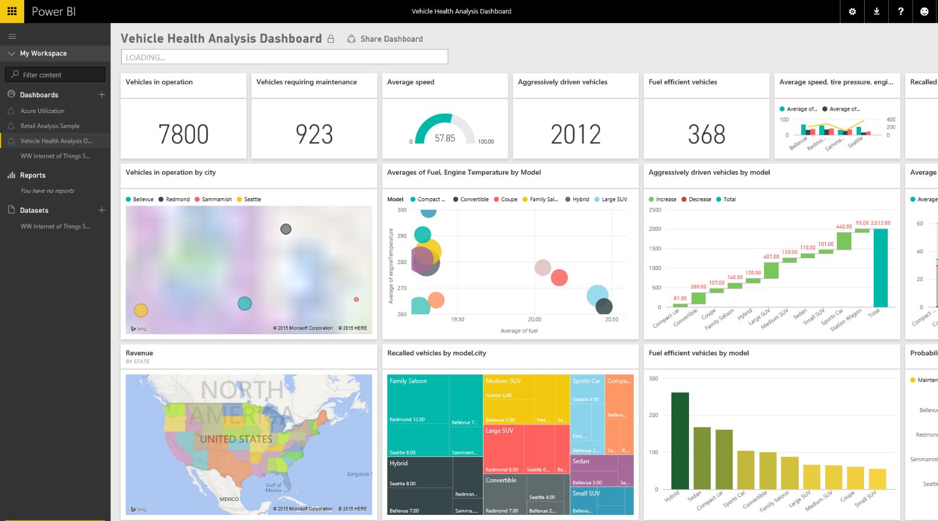
Data visualization with PowerBI
Rich visuals
Standard and custom graphing options
Custom dashboards
Build heat maps and visually track data
External data
Integrate external data feeds to add value to device data, or pull in external information such as weather or market information.
Notes:
Device data can be enriched by adding external data. Content packs are easily available within the PowerBI portal to add external information such as weather or traffic to name a few. Also integrate existing/proprietary/on-prem data from other business flows such as CRM or ERP. This allows the user to create very powerful overviews of the business and pull all data sources together for forecasting and business analysis.
External Data Integration
Integrate external data sets
Add other internal information flows – CRM/ERP
Global view of performance/health across business

Slide 21
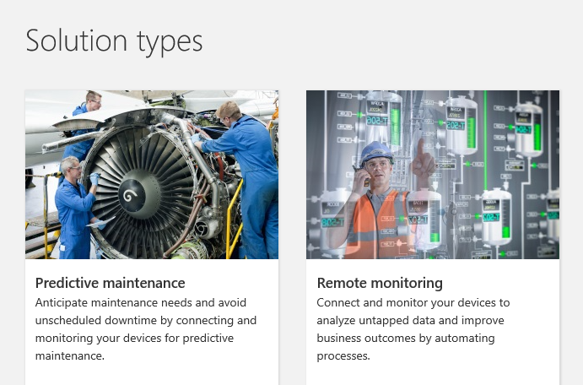
Azure IoT Suite
http://www.microsoftazureiotsuite.com/demos/predictivemaintenance
http://www.microsoftazureiotsuite.com/demos/remotemonitoring
https://www.AzureIoTsuite.com/

Slide 22
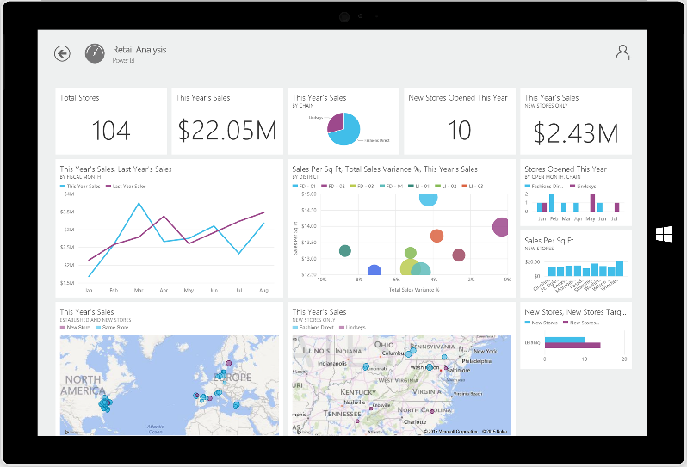
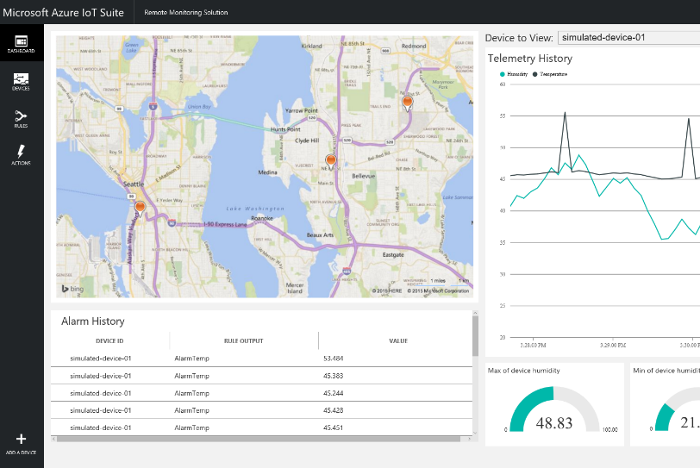
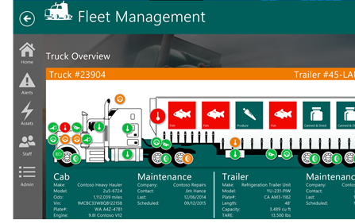
Tailor Azure IoT Suite to your needs using preconfigured solutions
Start quickly with preconfigured solutions
Finish with your Internet of Things application
Get started in minutes
Fine-tuned to specific assets and processes
Modify existing rules and alerts
Highly visual for your real-time operational data
Add your devices and begin tailor to your needs
Integrate with back-end systems

Slide 23
What you get with remote monitoring preconfigured solution
Azure IoT Suite Remote Monitoring
Web/Mobile App
Power BI
Devices
Back end systems and processes
Storage blobs
DocumentDB
C# simulator
IoT Hub
Stream Analytics
Event Hub
Web Jobs
Logic Apps
Azure
Active Directory
Notes:
This architecture diagram shows the individual Microsoft products and services that are utilized.
Provision simulated devices with a C# device emulator running .Net. Create agents for Linux, iOS, Android and other platforms with C and Java language support.
IoT Hub manages the two way communication between cloud and device and creates a secure command and control channel.
Azure Stream Analytics creates and manages jobs to recognize threshold values or detect alarm triggers, sending this information where it needs to be escalated.
Event Hub is queried by a web job running an event processor host to determine where and alarm or alert needs to be pushed – such as sending an alert to dashboard for a human operator to take action.
Logic Apps are used to create more complex work loads and integrate into line of business and other proprietary applications.
Document DB stores all the metadata and device properties for each connected device.
Blobs store telemetry information and telemetry data. Other tools such as Azure Machine Learning and PowerBI can access this information for data visualization or processing advanced analytics.
Webapp – Dashboard code is available in Github allowing it to be fully customized by the user to align with a scenario or be relevant for an enterprise application.
Azure Active Directory controls user ID’s and access, allowing the service to be shared with relevant decision makers within the business but restrict access to certain controls or devices.
PowerBI is used for both open-source embedded components within the dashboard and also for complex external analytics of trends and patterns across all stored data.

Slide 24

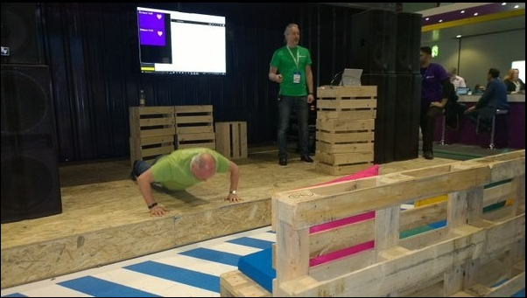
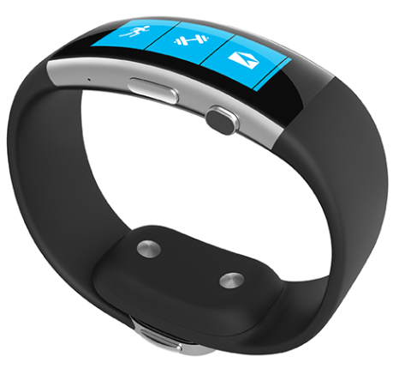
Demo – Band on the Run
https://github.com/bandontherun

Slide 25
